Slide 1
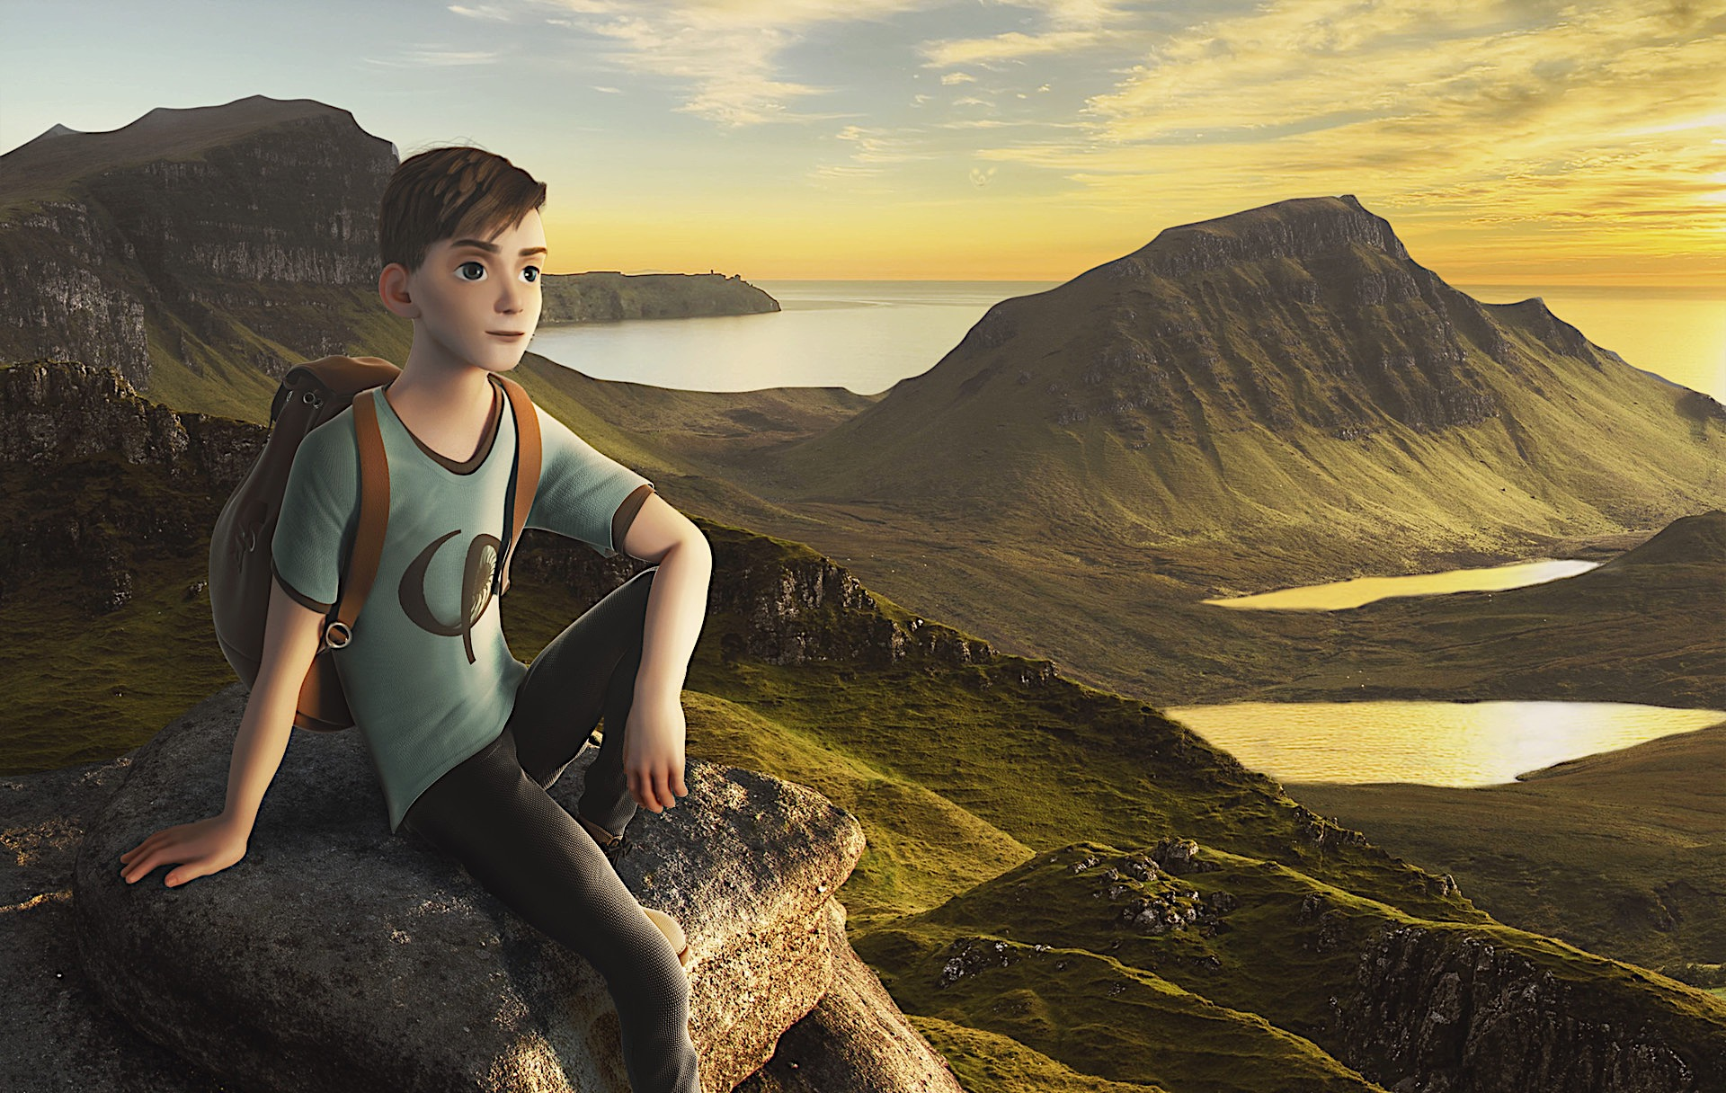
Creating 3D animation using Machine Learning
Azimov Otabek

Slide 2
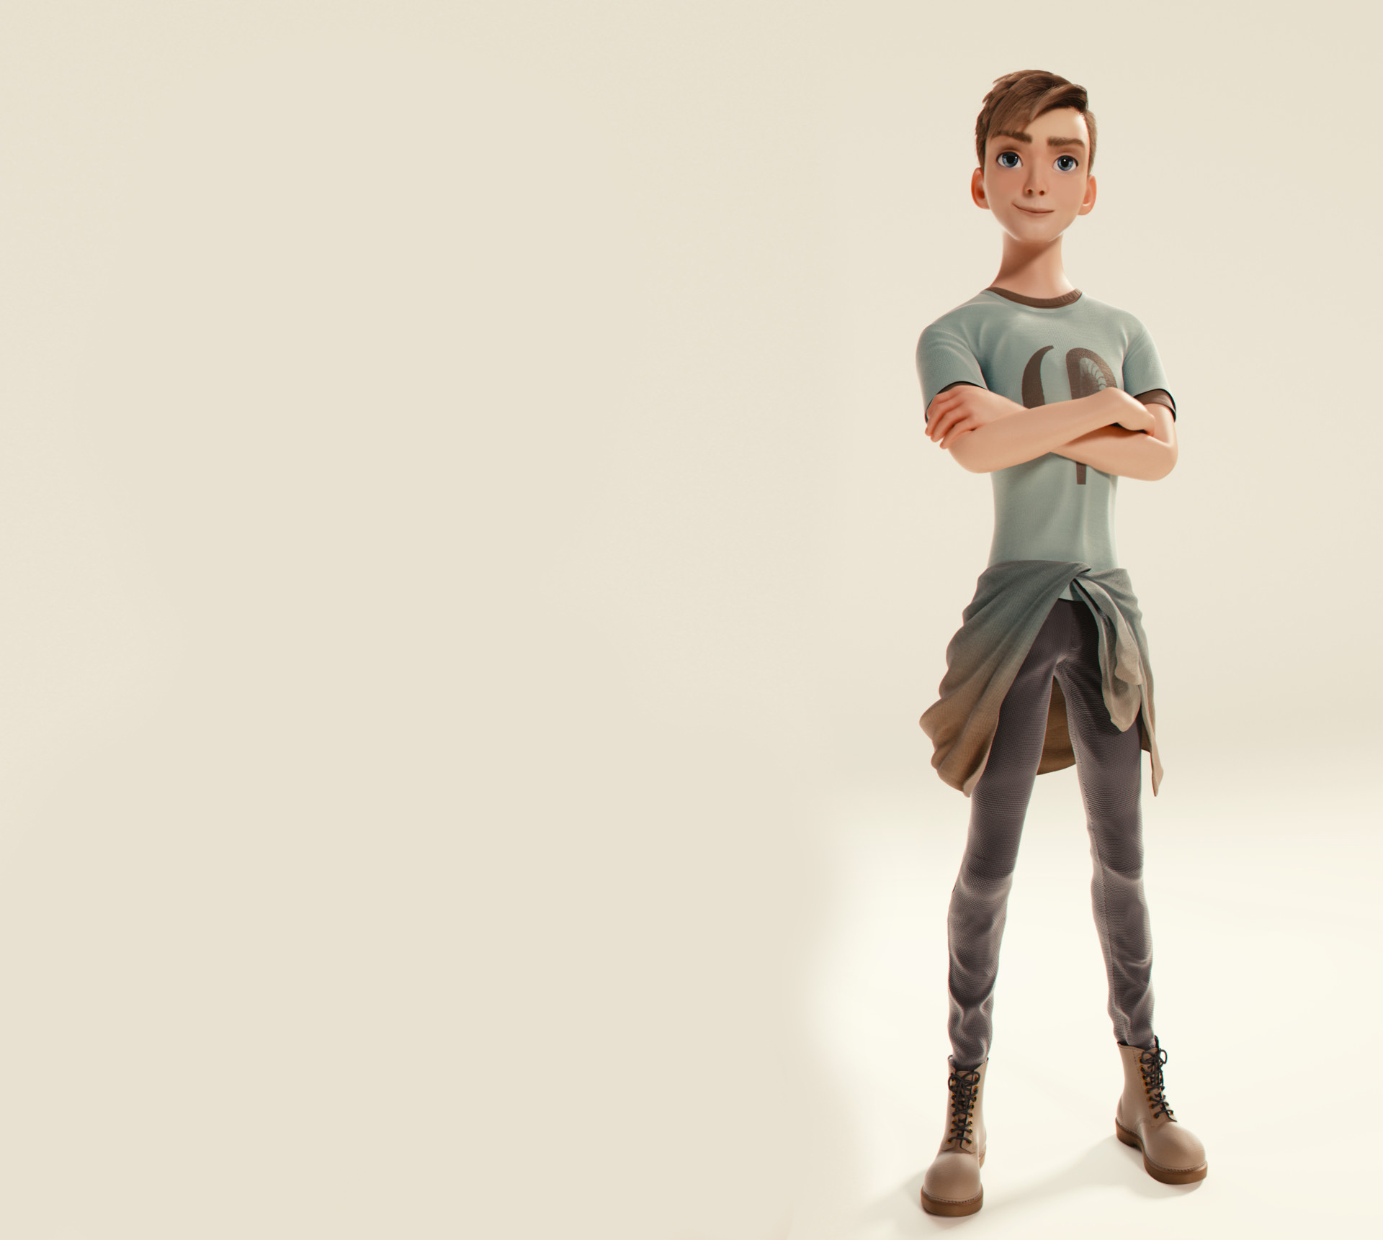
CONTENT
Introduction
Main problem
Solving of problem
Our Model As Solution
Conclusion
Azimov Otabek

Slide 3
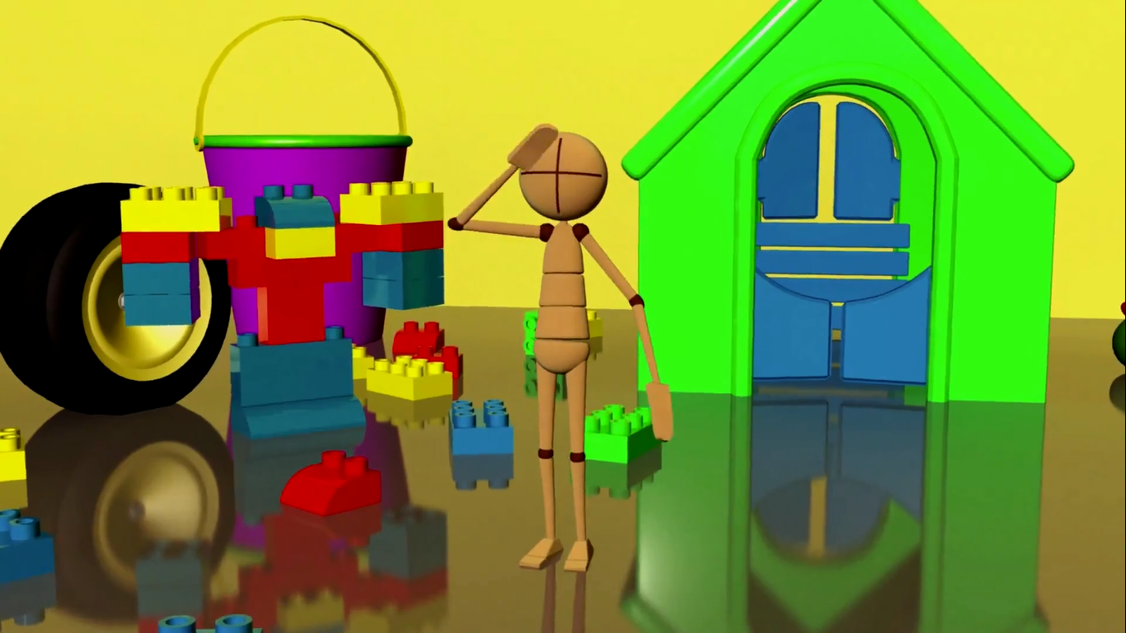
“People worry that computers will get too smart and take over the world, but the real problem is that they're too stupid and they've already taken over the world.” ― Pedro Domingos

Slide 4
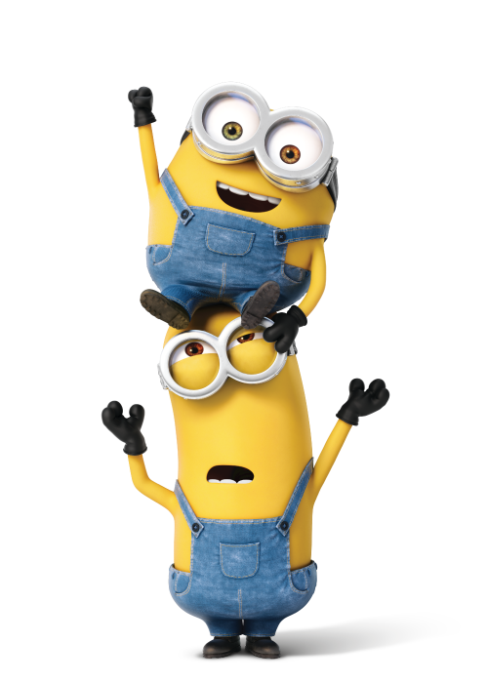
Main Problem
Implementation of 3D animations are made by special costumes. This process takes a very long time and it’s very expensive.
But I want to suggest a lighter method for creating 3D animations that will not take up valuable time.
Azimov Otabek

Slide 5
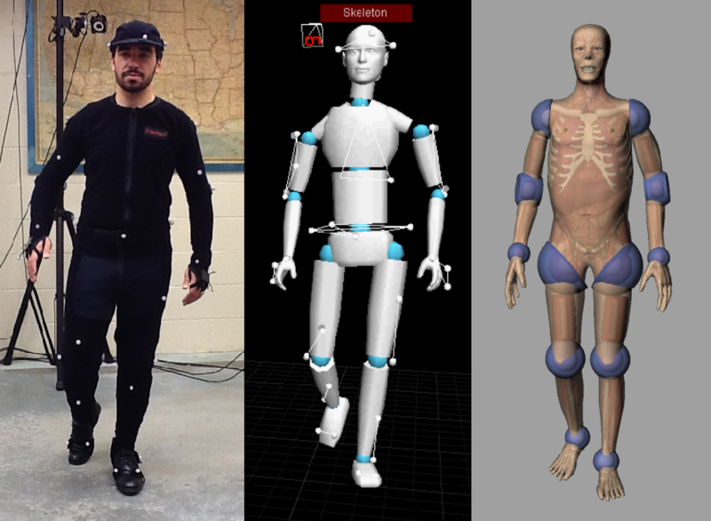

Slide 6
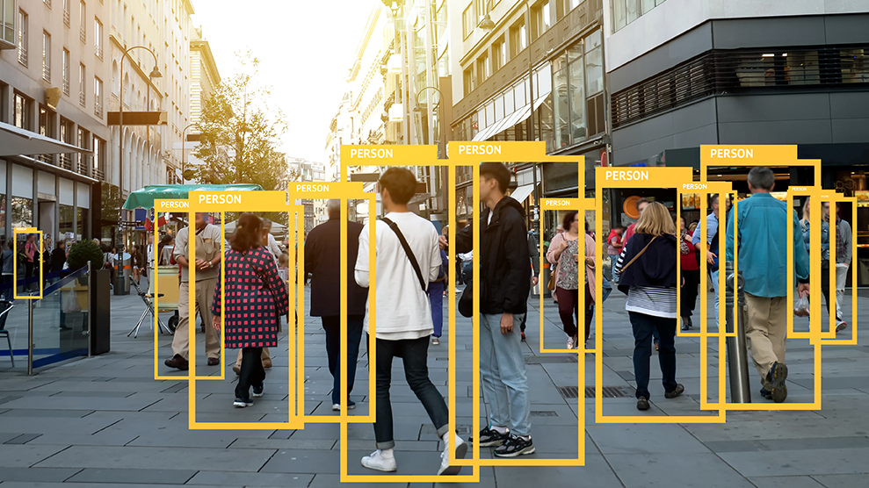
Solving of Problem
Creating 3D Motion Capture by using Kinect, ML and modeling apps
Creating 3D animation by Using Machine Learning Functions
Creating Motion Mockups with help of ML to recognize your actions

Slide 7
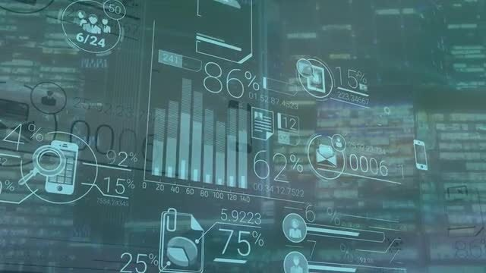
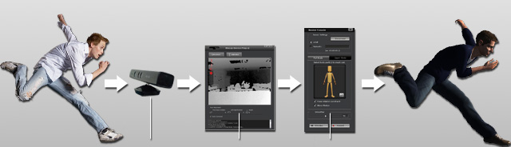
Creating 3D Motion Capture by using Kinect, ML and modeling apps
*** There also we have Machine Learning ***

Slide 8

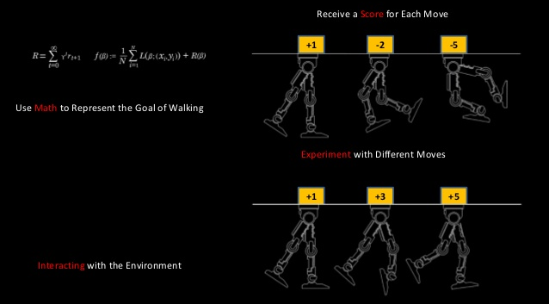
Creating 3D animation by Using Machine Learning Functions

Slide 9
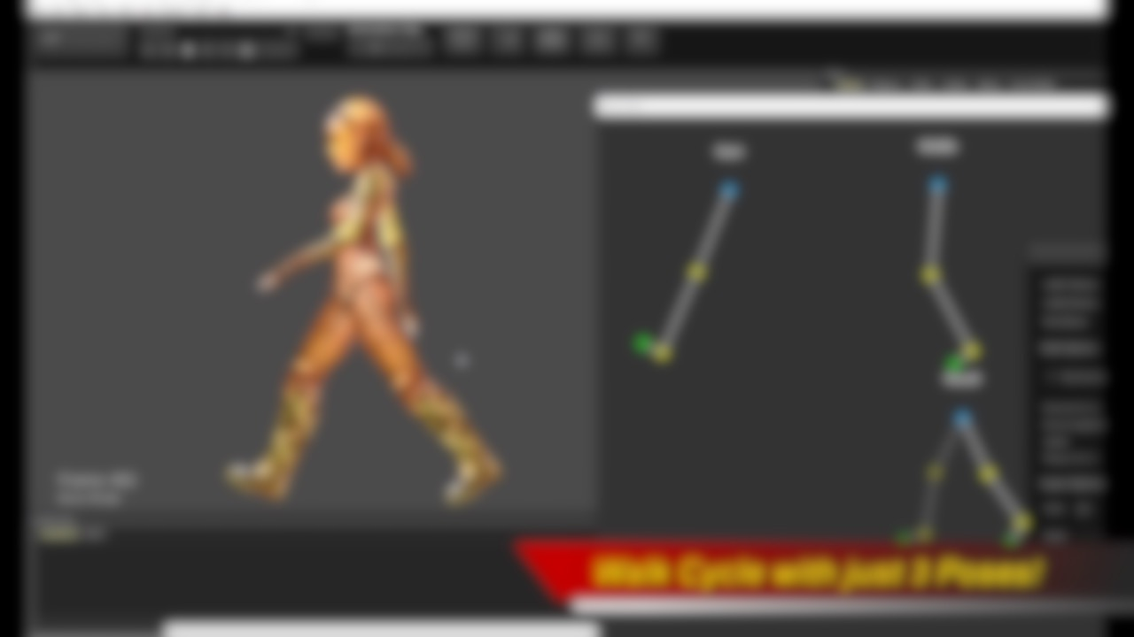
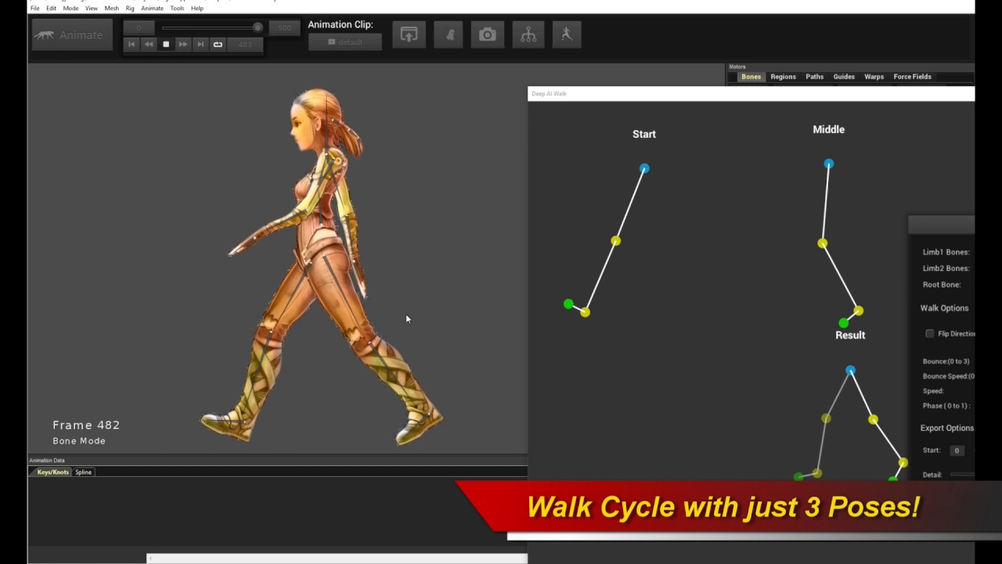

Slide 10


THE FULL MOVIE OF MODEL IS COMING SOON

Slide 11
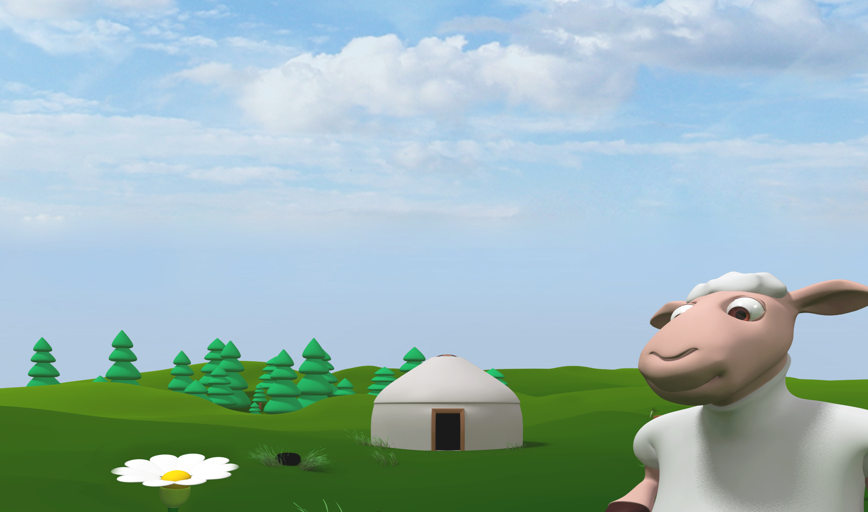
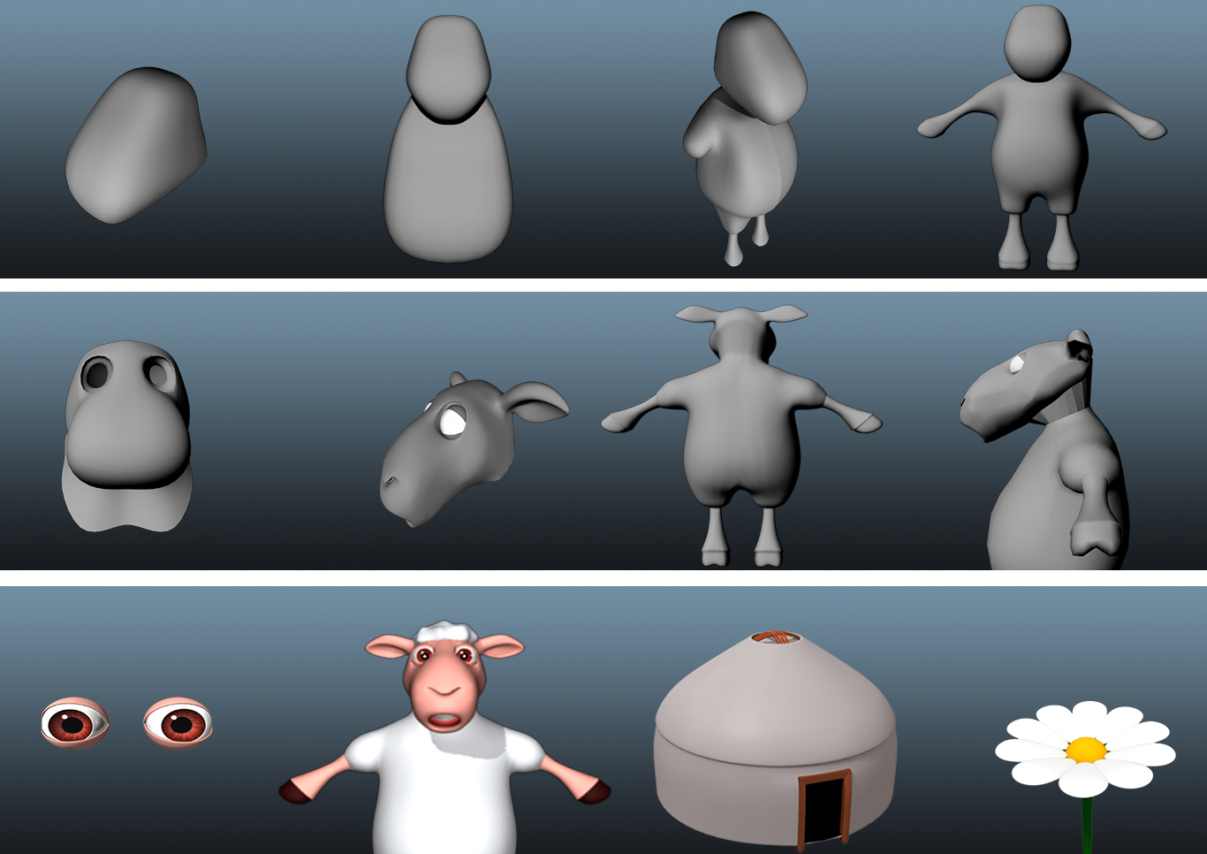
SOME SCREENSHOTS OF PROJECT MODEL

Slide 12
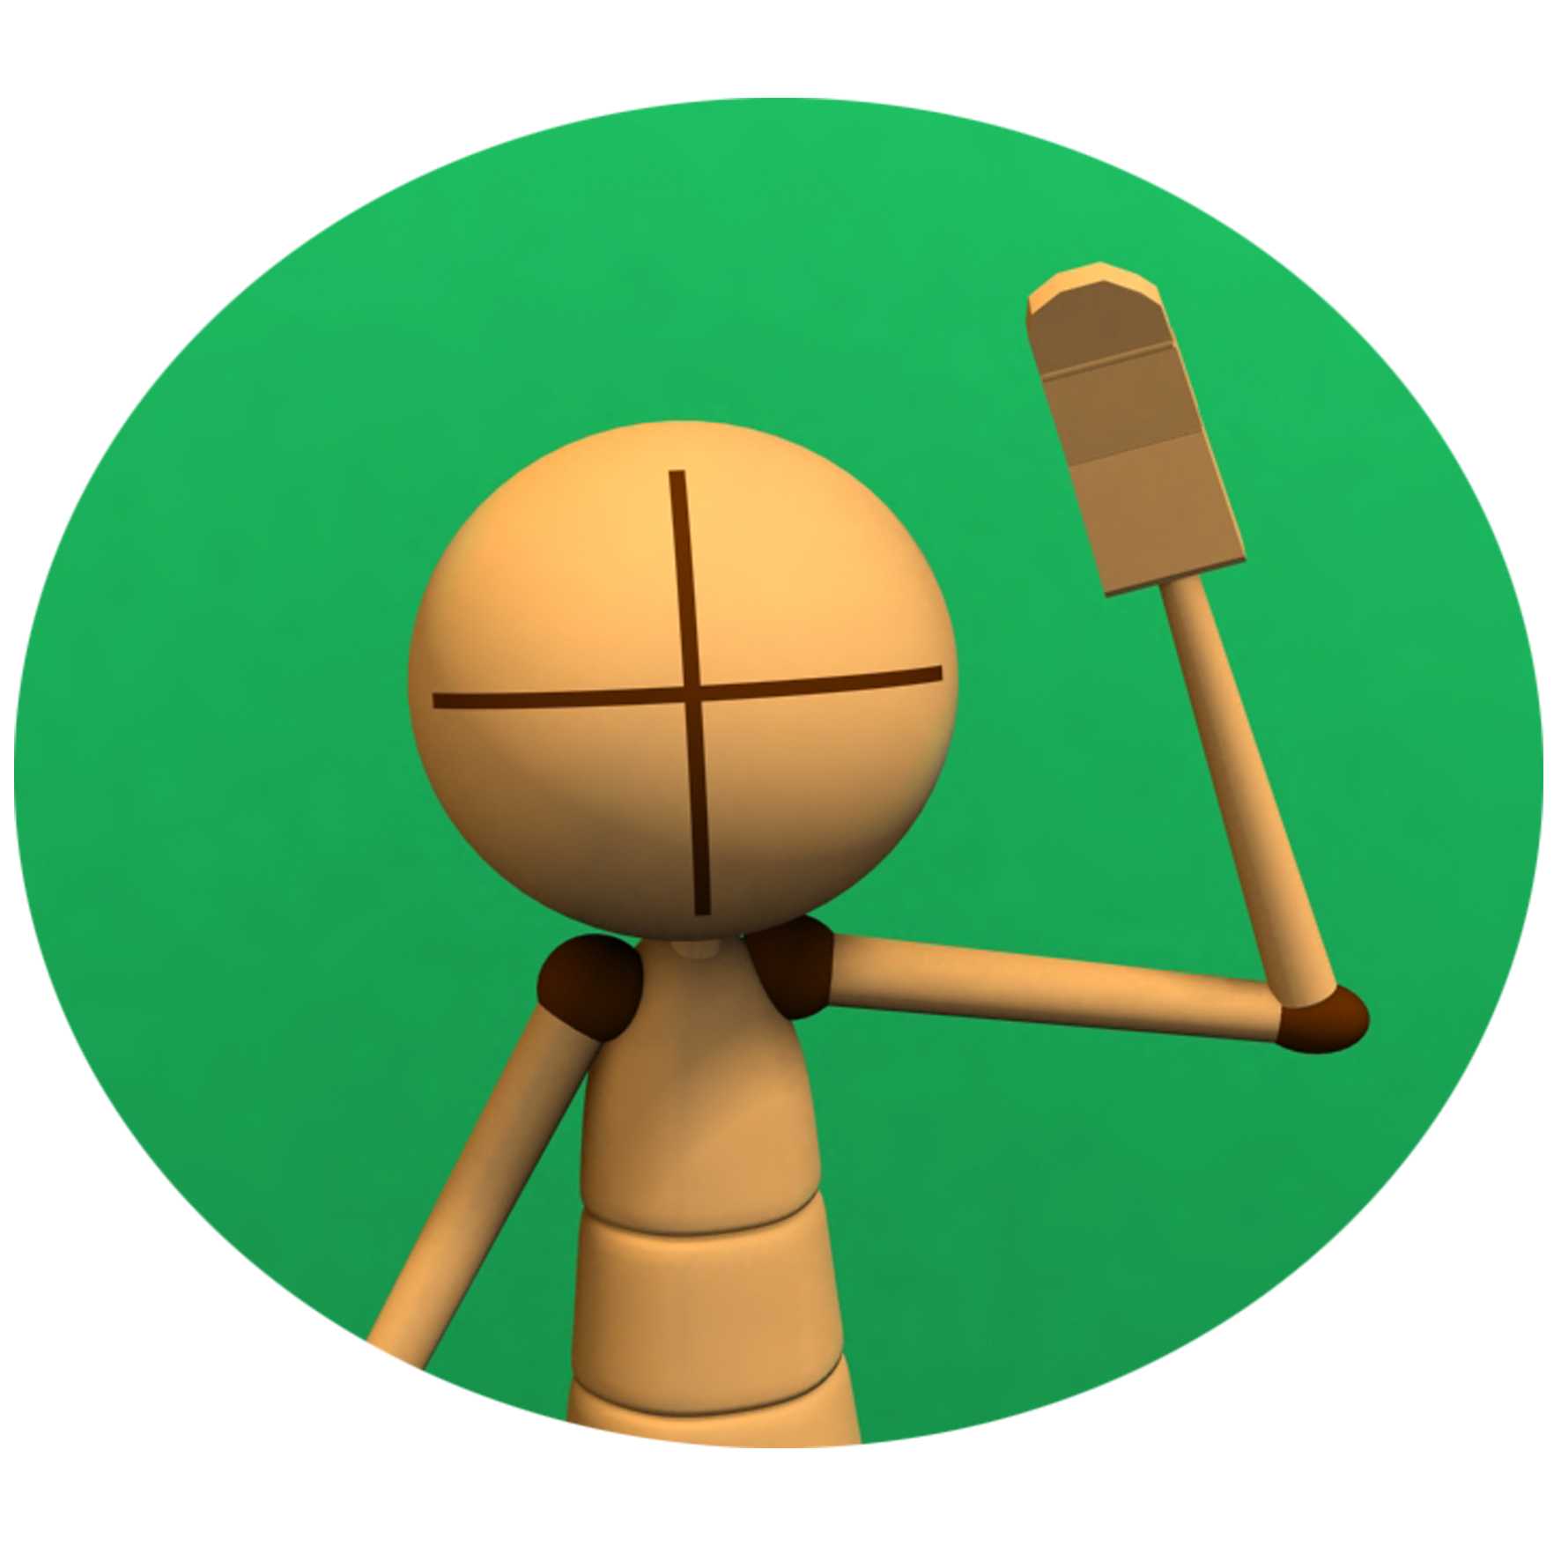
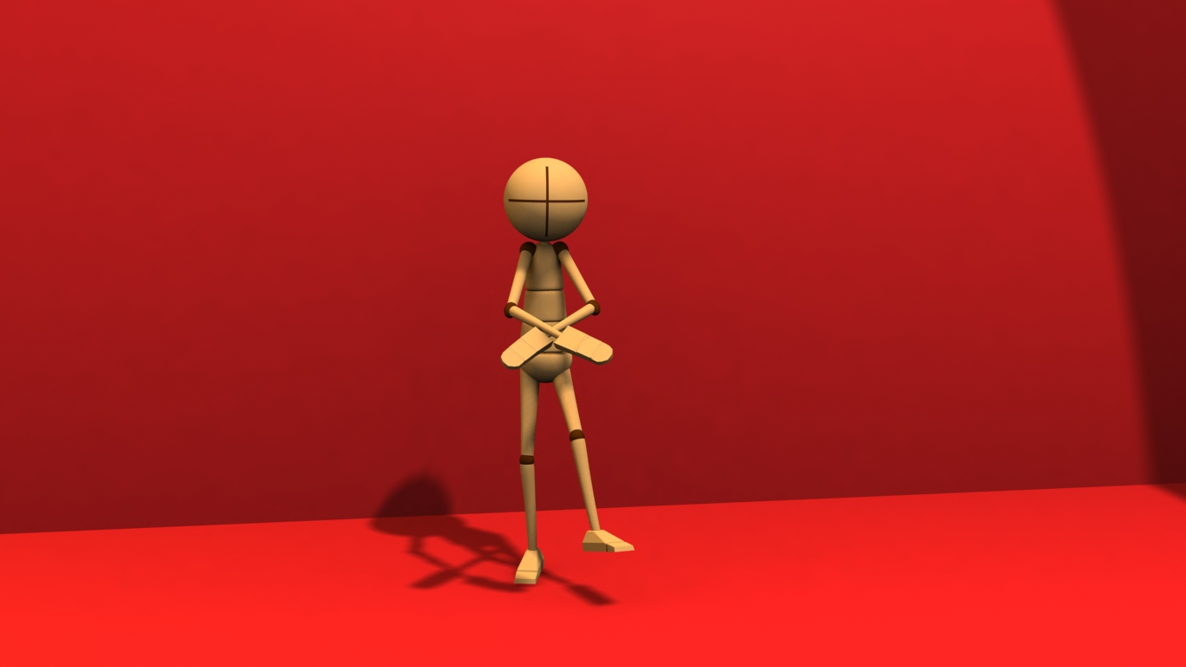
SURPRISE IS COMING! THANKS FOR ATTENTION

